Slide 1
Leading your chapter The Honor Society of Phi Kappa Phi
Jami Prince, Ed.D.
Director of Chapter Services

Slide 2
Agenda
Leadership succession
Resources for chapter officers
Fall training opportunities

Slide 3
Introductions
Just three words…

Slide 4
Building your team

Slide 5
Chapter Officer Service
Just three words…

Slide 6
Bylaws
Article II, Section 3.1---The elected officers will include at minimum an executive committee composed of:
President
President-Elect
Secretary
Treasurer
Student Vice President
Additional offices may be established as the chapter may prescribe…

Slide 7
Building your team
Begin with initiation

Slide 8
bylaws
Article III, Section 4--Members of the institution’s faculty, administration, professional staff, alumni, or community leaders who exhibit excellence and high ethical standards may be extended membership.

Slide 9
bylaws
Article III, Section 3.41--The number invited may not exceed 4 percent of the number of students invited by the chapter that year.
Article III, Section 3.42--Chapters that invite fewer than 200 students per year may be allowed to initiate a maximum of eight persons per year.

Slide 10
Table talk
How does your chapter decide which faculty, staff, and administrators to initiate?
How do you extend the invitation?

Slide 11
Building your team
Have you initiated your campus president?
Have you initiated your provost?
Have you initiated your deans?

Slide 12
Building your team
Have you initiated your registrar?
Have you initiated your advisors?
Have you initiated your campus communications director?

Slide 13
Identifying new leaders

Slide 14
Table talk
How does your chapter identify new officers?
How does your chapter identify new student vice presidents?

Slide 15
Top Ten tips….and more
Find a powerful advocate to support you. The provost’s office is the ideal place to find support for the chapter.

Slide 16
Top Ten Tips
Ask if service as a chapter officer is recognized as service for tenure and promotion.

Slide 17
Top Ten Tips
Ask your provost or deans to recommend future chapter officers.

Slide 18
Top ten tips
Ask for support from your honors college or program.

Slide 19
Top ten tips
Consider asking people to take on small tasks, such as serving on a committee, which can lead to larger tasks at a later date.

Slide 20
Top ten tips
Ask people in different units so the executive committee reflects the interdisciplinary nature of Phi Kappa Phi.

Slide 21
Top ten tips
Ask librarians.

Slide 22
Top ten tips
Ask someone whose skill set matches the open position.

Slide 23
Top ten tips
Ask those admired by students.

Slide 24
Top ten tips
Ask in person.

Slide 25
Top ten tips
Stay in touch with those who say, “Not now”.

Slide 26
Top ten tips
Consider the career stage of the faculty member.

Slide 27
Top ten tips
Don’t decide for others if they are too busy.

Slide 28
Top ten tips
Be enthusiastic and encouraging.

Slide 29
Resources for chapter officers

Slide 30
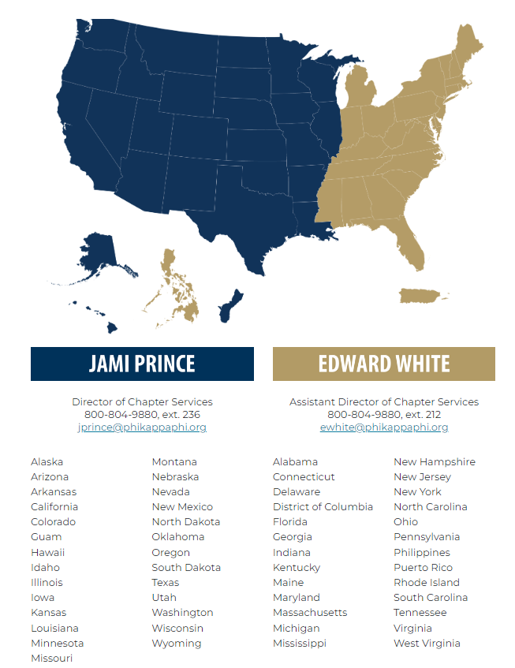
resources
Jami Prince, Ed.D.
Director of Chapter Services jprince@phikappaphi.org
Edward White, DMA
Assistant Director of Chapter Services ewhite@phikappaphi.org
__________________________________
Nicole McAlister
Chapter Communication Coordinator
chapters@phikappaphi.org
Kay White, DMA
Enrollment Manager join@phikappaphi.org

Slide 31
resources

Slide 32
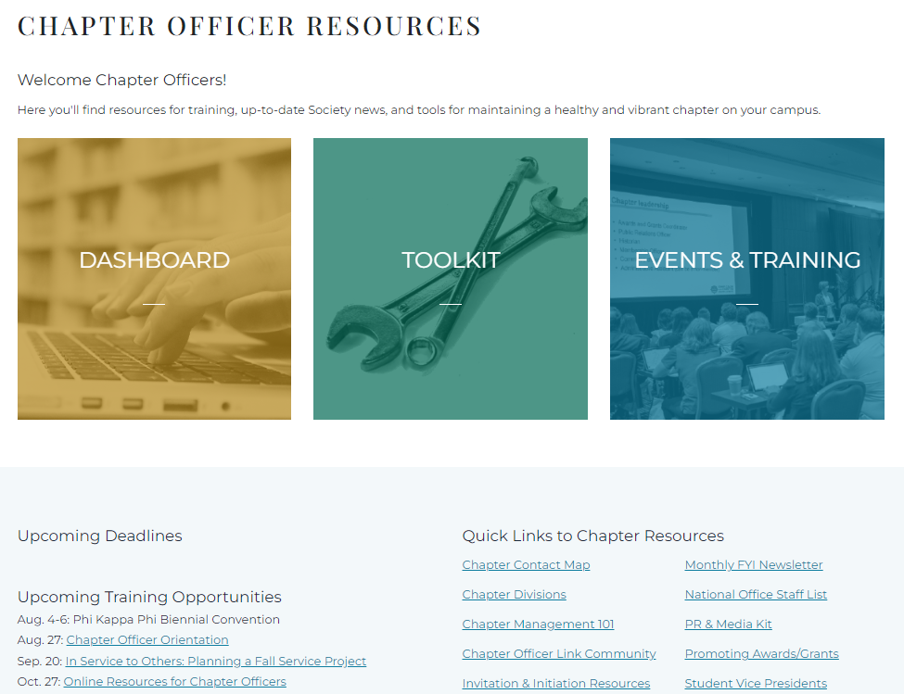
resources

Slide 33
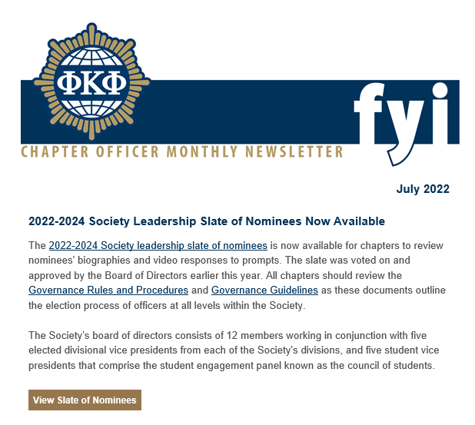
resources
Chapter officers receive a monthly electronic communication from the Chapter Services Department called “Monthly FYI”.

Slide 34
Fall training opportunities

Slide 35
Chapter officer orientation
Saturday, Aug. 27 | 10 a.m. - 12 p.m. CT
Embrace your love of learning and join us on Zoom for a chapter officer orientation session!

Slide 36
Coffee Calls
Tuesday, Sep. 20 | 11-11:30 a.m. CT In Service to Others: Planning a Fall Service Project
Thursday, Oct. 27 | 12-12:30 p.m. CT Online Resources for Chapter Officers
Wednesday, Nov. 16 | 1-1:30 p.m. CT Building Your Phi Kappa Phi Leadership Team

