Slide 1

Leadership Lessons from the First Vice Presidents for Students

Slide 2
Agenda
Introductions
The Inaugural Council of Students
The Inaugural VP for Students
Lessons from the SVP Handbook
Lessons from a Strong PKP Chapter
Using Leadership to Explain PKP
Ideas to Strengthen Your Local Chapter
Break-out Session: Chapter Ideas
Leadership Advice
Q&A

Slide 3
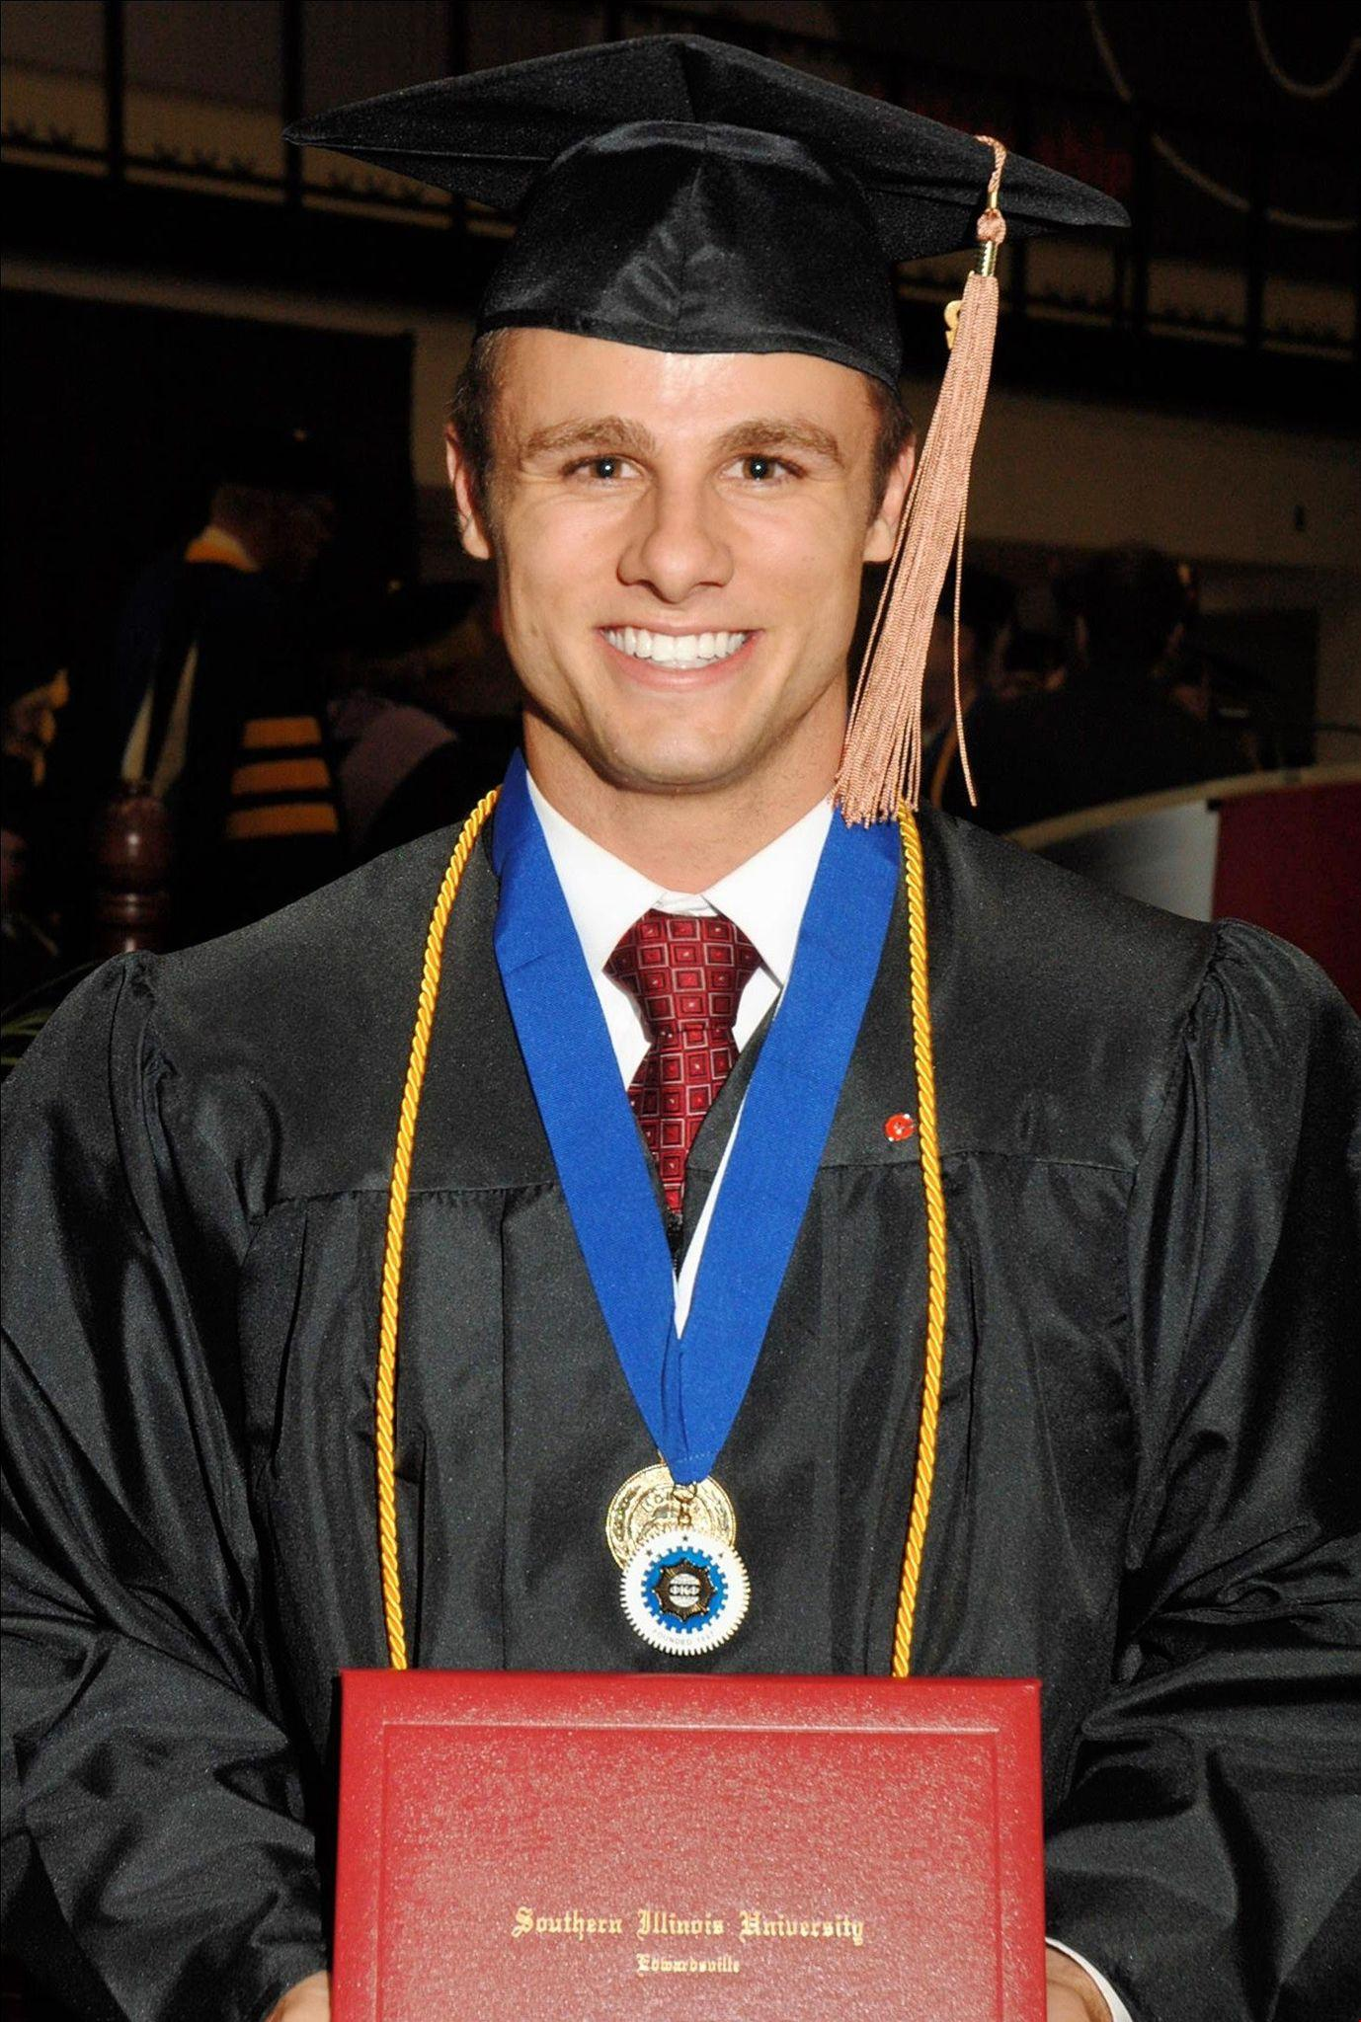
Jeffry Harrison
Inaugural PKP Council of Students
Inaugural VP for Students on the PKP Board
Former Student Trustee on the SIU Board
Co-Founder & President at Rovertown
Lives in Midland, MI with his family of five
Hobbies = Golf, Bourbon, Snowboarding

Slide 4
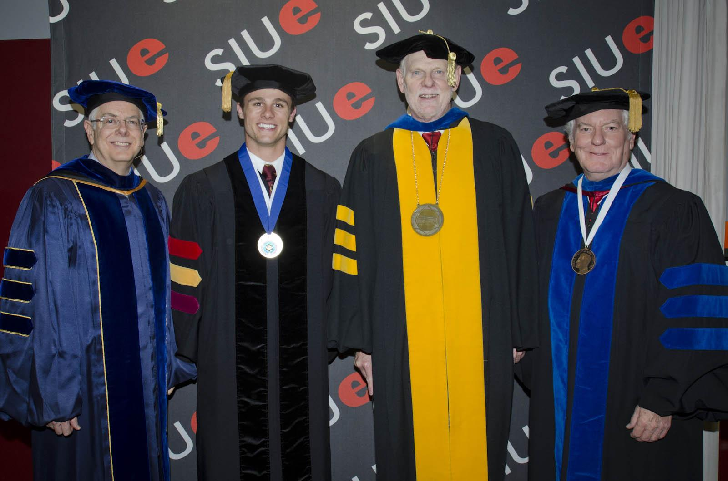
Jeffry’s Phi Kappa Phi Story

Slide 5
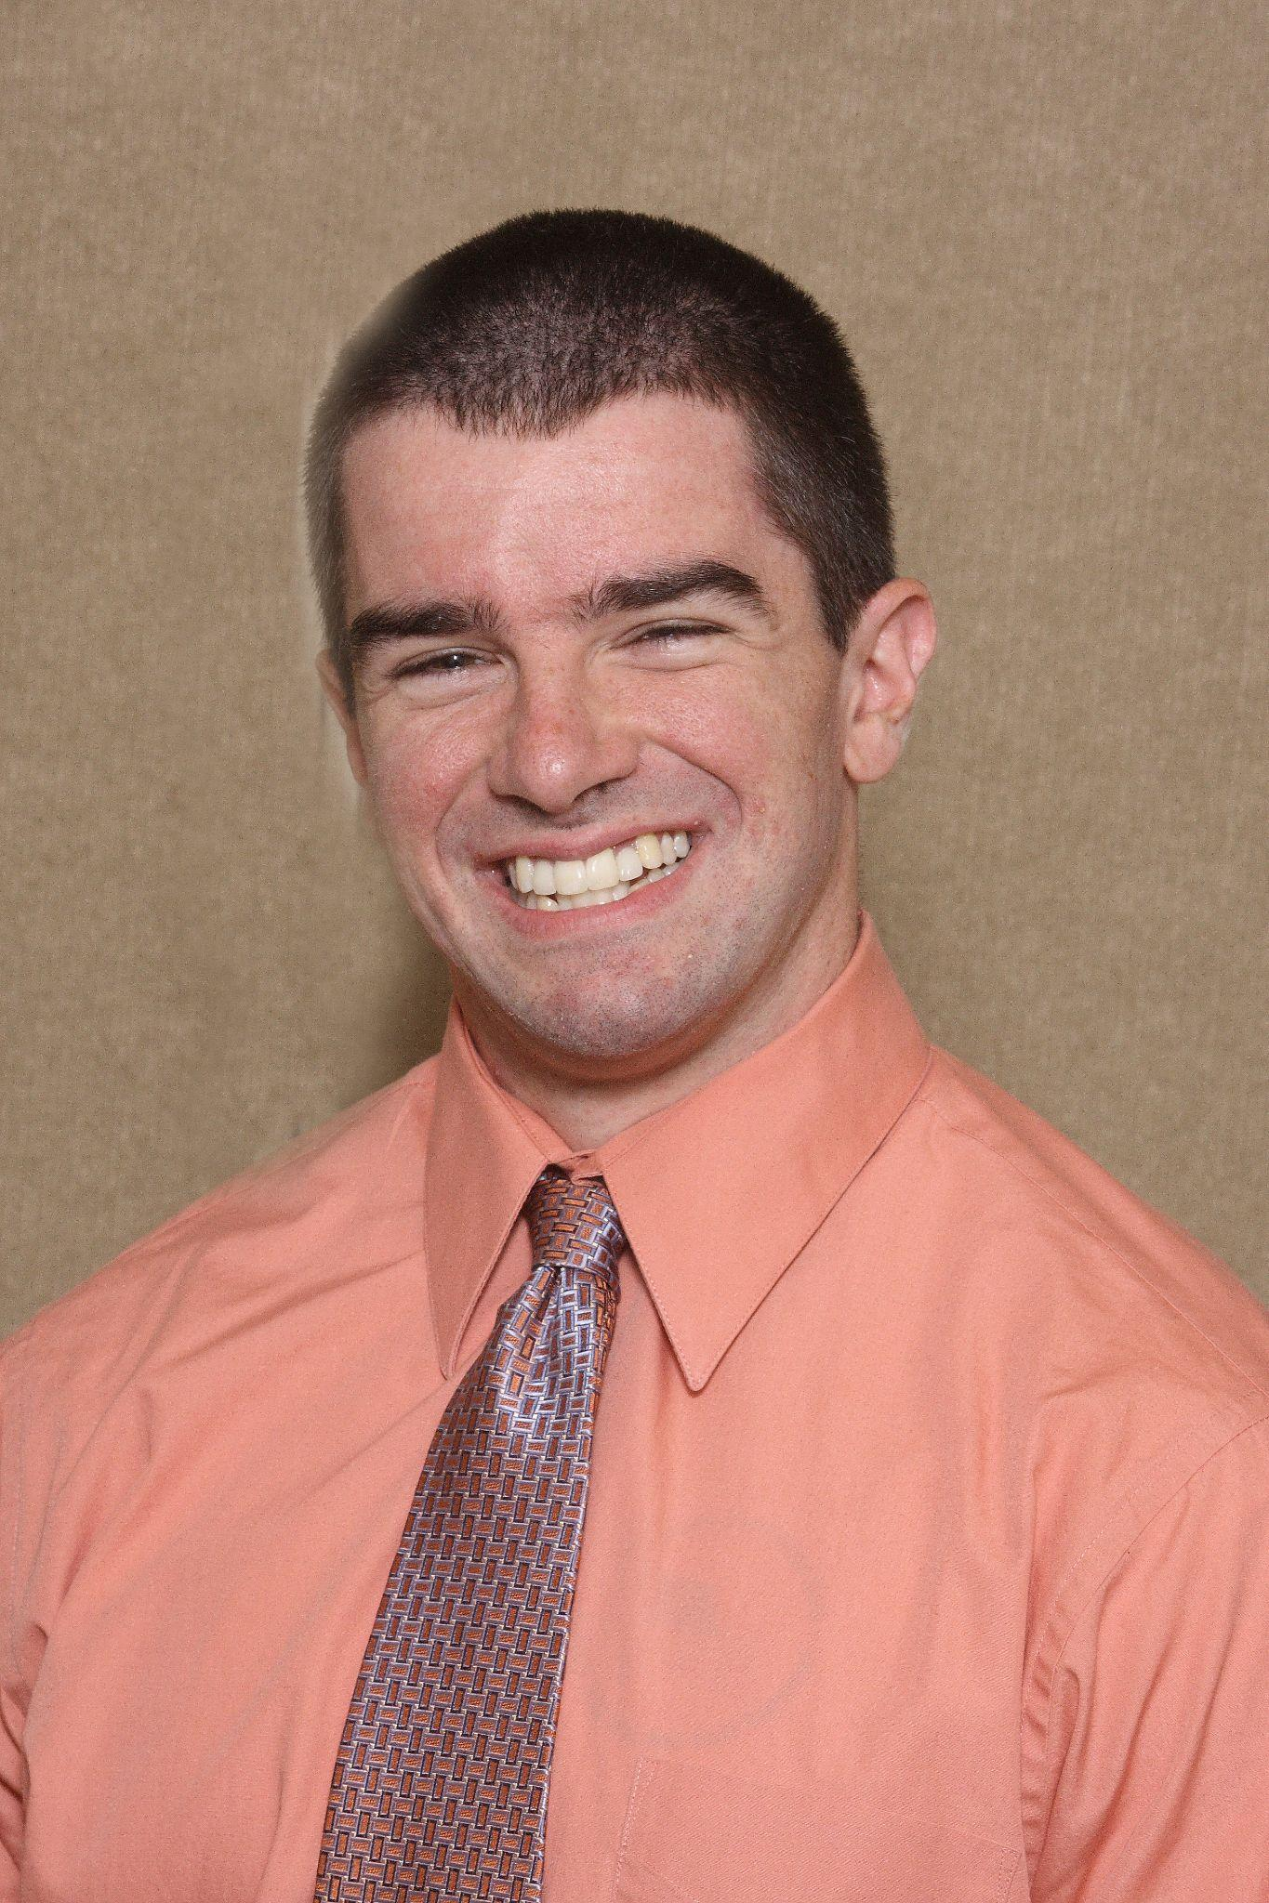
Rodney Hughes
Inaugural PKP Council of Students
Inaugural VP for Students on the PKP Board
Former Penn State Student Trustee
Associate Professor at WVU
Lives in Canonsburg, PA with family of three
Hobbies = Trivia and Working Out

Slide 6
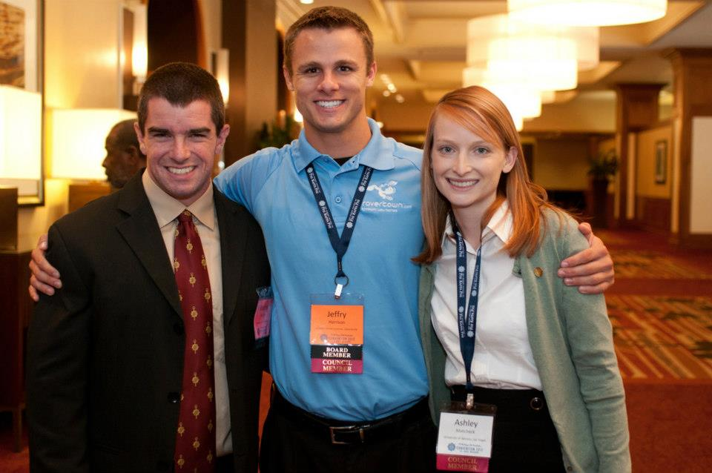
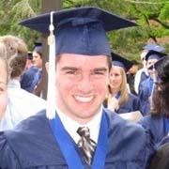
Rodney’s Phi Kappa Phi Story

Slide 7
What is the lifeblood of PKP?

Slide 8
Students

Slide 9
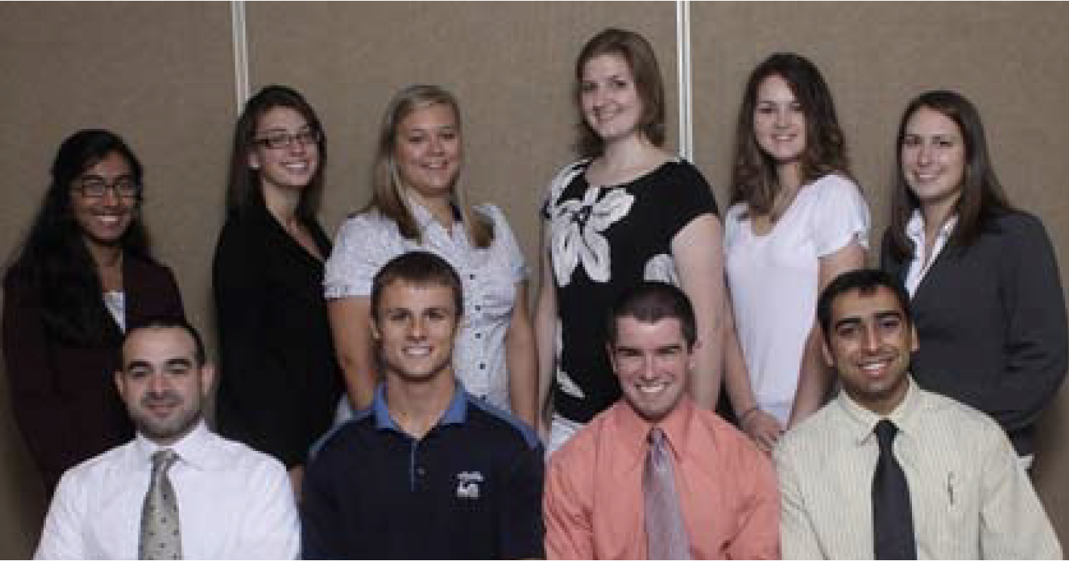
The Inaugural Council of Students

Slide 10
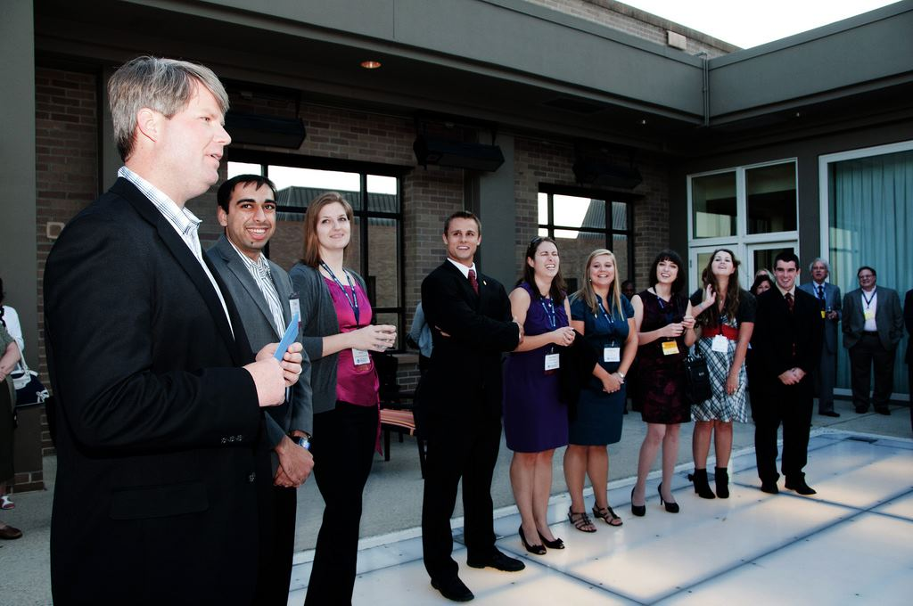
The Inaugural Council of Students

Slide 11
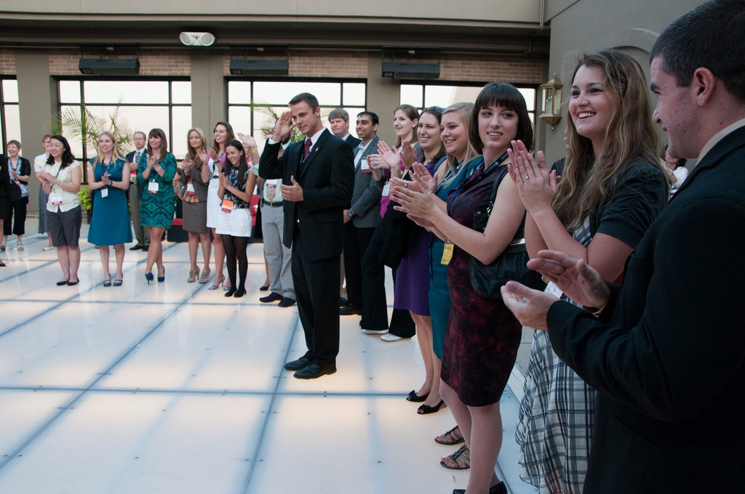
The Inaugural Council of Students

Slide 12
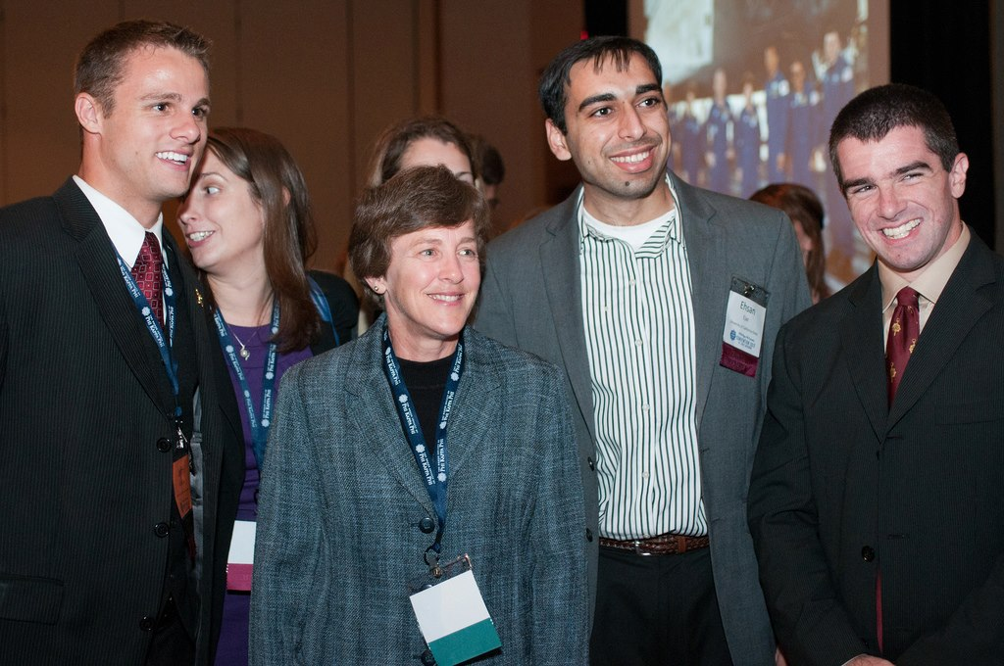
The Inaugural Council of Students

Slide 13
Inaugural COS Accomplishments
Formed in 2010 w/ 10 SVPs from 5 regions
Created the first PKP SVP Handbook
Created the first PKP COS Guidebook
Established the framework for future COS
National Service Project Initiative
Partnering for Success Workshops
COS participated at several inductions
  Most notably, UP-Manila

Slide 14
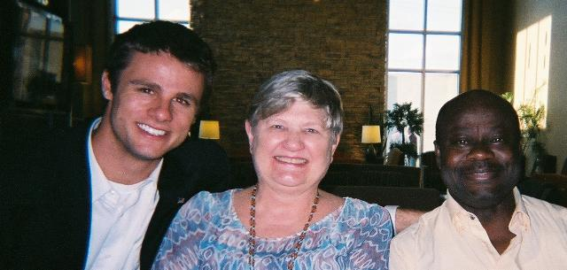
The Inaugural VP for Students

Slide 15
Lessons from the SVP Handbook
To promote PKP, you must know PKP
Ideas to strengthen your local chapter
Setting up a “Blitz” on your campus
Giveaways and Phi Kappa Phi swag are 😎
Set consistent chapter meetings
Become a campus recognized student org
Understanding the importance of Inductions
Your time as SVP is brief, make the most of it

Slide 16
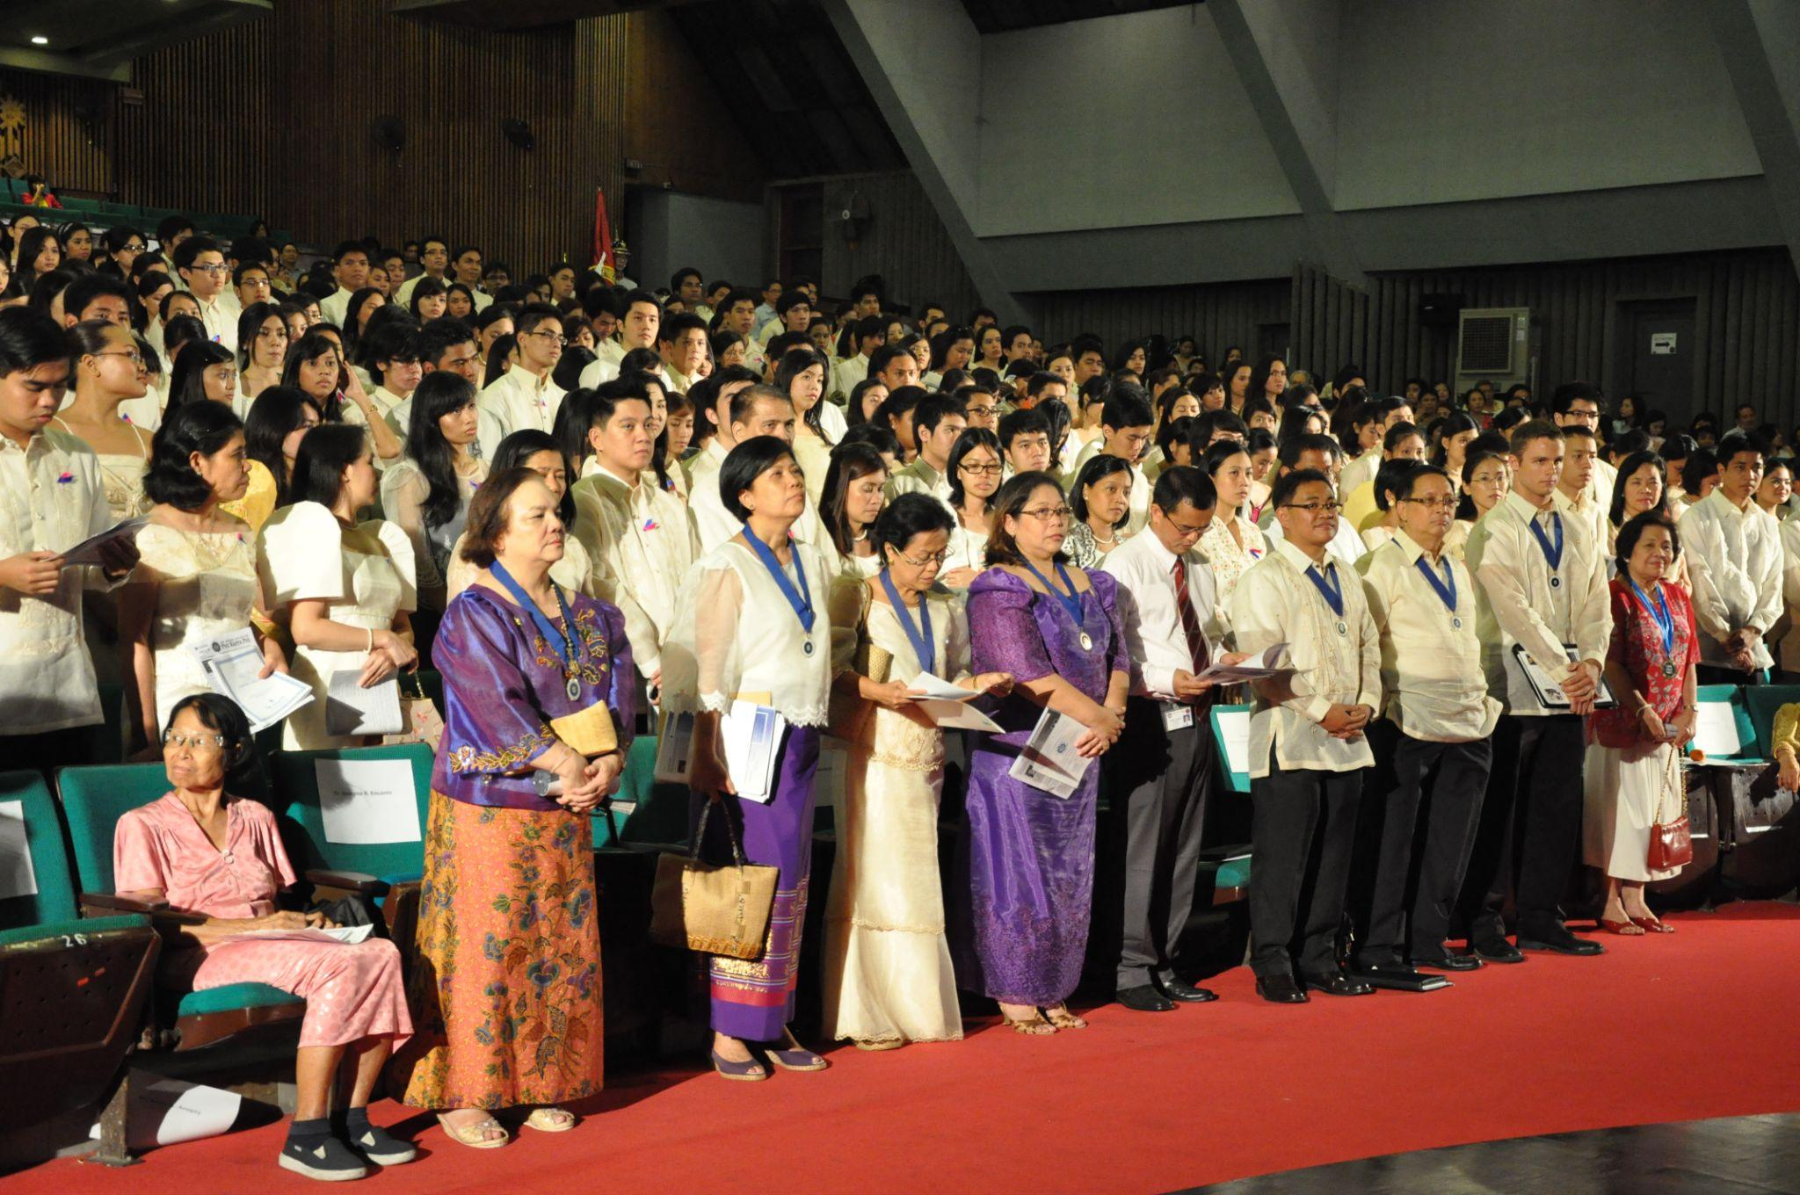
A Strong PKP Chapter

Slide 17
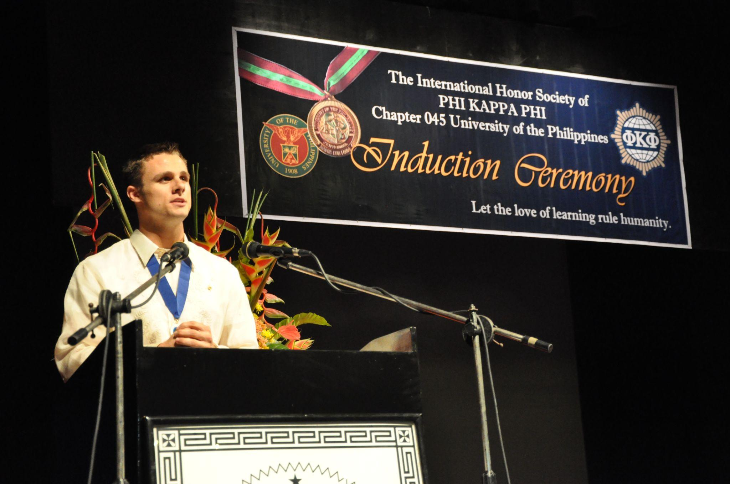
A Strong PKP Chapter

Slide 18
Lessons from the UP-Manila
Phi Kappa Phi is in their DNA
Strong chapter leadership with a clear succession plan
Well known presence on campus
Amazing marketing
  They have a Facebook Page with almost 4,000 Followers 🤯
Their induction ceremonies are basically the Academy Awards

Slide 19
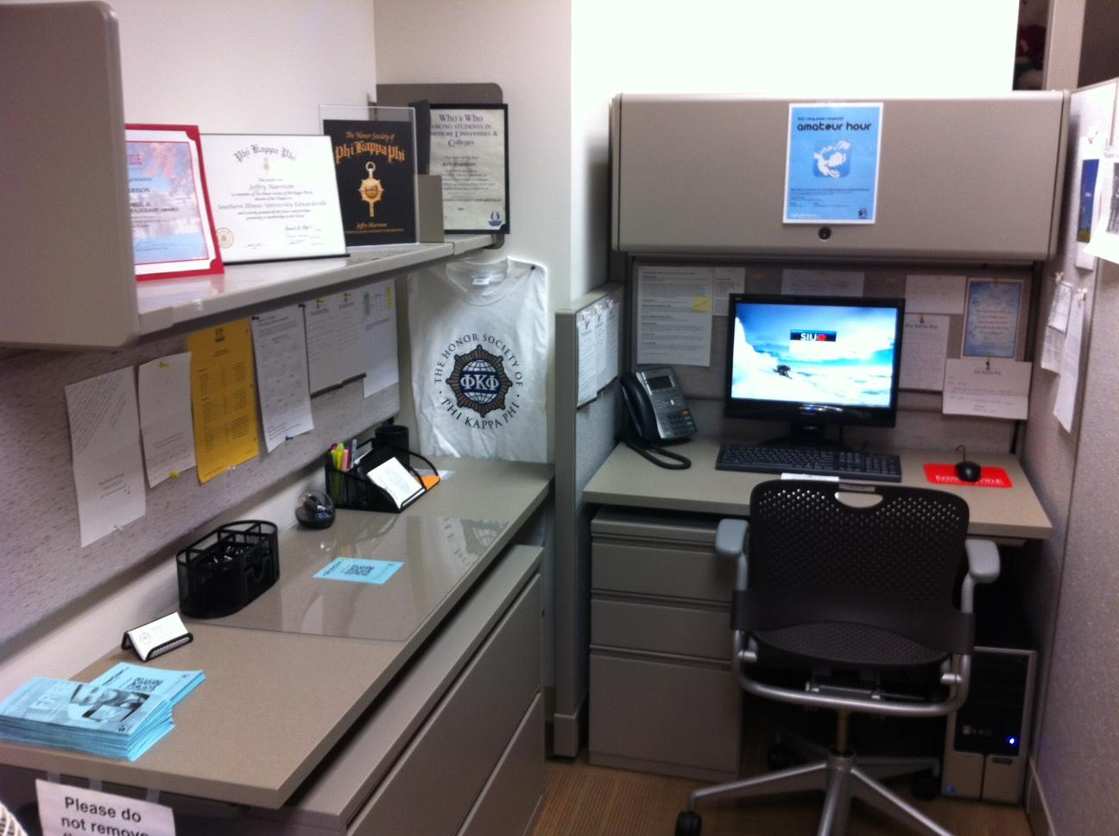
Passion for Your Local Chapter

Slide 20
Using Leadership to Explain PKP
Highly Selective Membership
Leadership Opportunities
  Council of Students, VP for Students
People Trust People, Not Paper
Personally invite all potential members
  Best done through an event
The Value of PKP Awards
  $1,300,000 Awarded Annually
  10 Award Categories
  Study Abroad Award ($1,000/each)

Slide 21
Ideas to Strengthen Your Local Chapter
Reference the SVP Handbook
Induct Freshmen/Sophomores for longevity
Create a sense of community/passion
Connect with other SVPs from your region
Build a relationship with PKP HQ
  They want to help you!
Stay connected with local chapter alumni
Send words of encouragement to all chapter members at the start of each semester

Slide 22
Breakout Session: Chapter Ideas
Breakout into groups of 6-8
What’s the best leadership advice you have ever received?
How can Phi Kappa Phi be better?
How can you better lead your chapter?
How can you increase initiation?

Slide 23
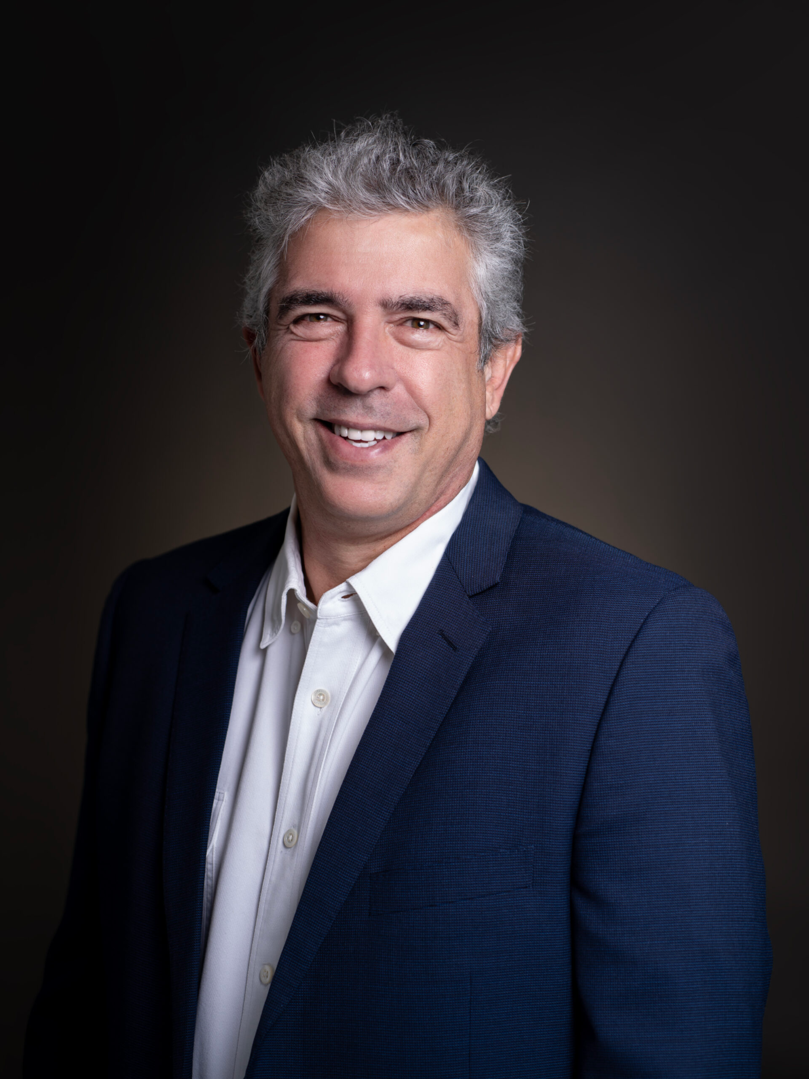
Leadership Advice
“You can delegate authority, not responsibility.” -Dion Joannou (Accedian)

Slide 24
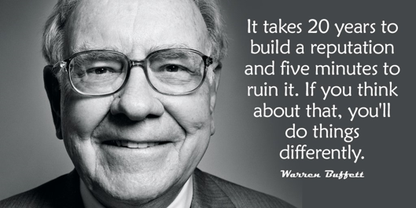
Leadership Advice

Slide 25

Leadership Advice

Slide 26
Leadership Advice
Let’s think about adversity.
Especially when things are going well: in college, performing well academically, getting involved.
Then, the longer it takes to materialize, the higher the stakes are when it happens.

Slide 27
Leadership Advice
How can you stay “in it” and stay engaged despite experiencing adversity?
Humility is one idea;
Mission or purpose is another idea.

Slide 28
Leadership Advice
“If you see a turtle on a fence post, you know it didn’t get there by itself.”
“If you can hit a baseball 33 percent of the time for your whole career, you’re in the
Hall of Fame.”
“You have to be willing to pump gas.”

Slide 29
Q&A

